Slide 1
Prioritizing Content of Interest in Multimedia Data Compression
Chong Shao
University of North Carolina at Chapel Hill
Advisor: Shahriar Nirjon, Russell Taylor
Notes:
Give a practice talk about my research, as a practice talk for defense
The title is …
TODO: update the slides with the IoTDI talk slide
TODO: update analysis aware compression reuslt plots
TODO: label the line with. The formula
TODO: actual beacon deployment in the department
TODO: page 18+6 formula approximate
TODO: explain the evaluation: how these things are linked
TODO: page 60+6, why huffman coding is H?
TODO: maybe a slide talk about adding synthesized noise into video
TODO: page 43+6 may add the benchmark plot
TODO: more formula about localization can be added
TODO: page 39+6, talk a little more about how it relates to microscopy
TODO: page 21+6 add original video
TODO: page 71+6 formula explain
TODO: "paper on this" before every project
TODO: add comparison in most of the results to the existing best method
TODO: 46 generalizability?
XXX details about H.264: how it handles the region of interest ?????
Xxx read the nature paper
Xxx read the microscopy paper
https://www.statista.com/chart/3780/tv-screen-size/
http://drpeering.net/white-papers/Internet-Transit-Pricing-Historical-And-Projected.php
http://blog.dshr.org/2016/05/talk-at-seagate.html
http://blog.dshr.org/2014/03/the-half-empty-archive.html
http://ieeexplore.ieee.org/xpl/login.jsp?tp=&arnumber=6269460&url=http%3A%2F%2Fieeexplore.ieee.org%2Fxpls%2Fabs_all.jsp%3Farnumber%3D6269460
http://dl.acm.org/citation.cfm?id=290814
http://ieeexplore.ieee.org/xpl/login.jsp?tp=&arnumber=4387595&url=http%3A%2F%2Fieeexplore.ieee.org%2Fxpls%2Fabs_all.jsp%3Farnumber%3D4387595

Slide 2

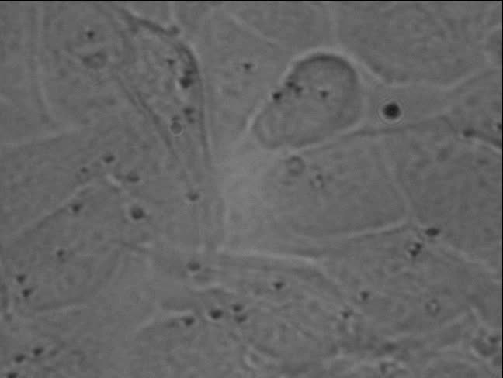
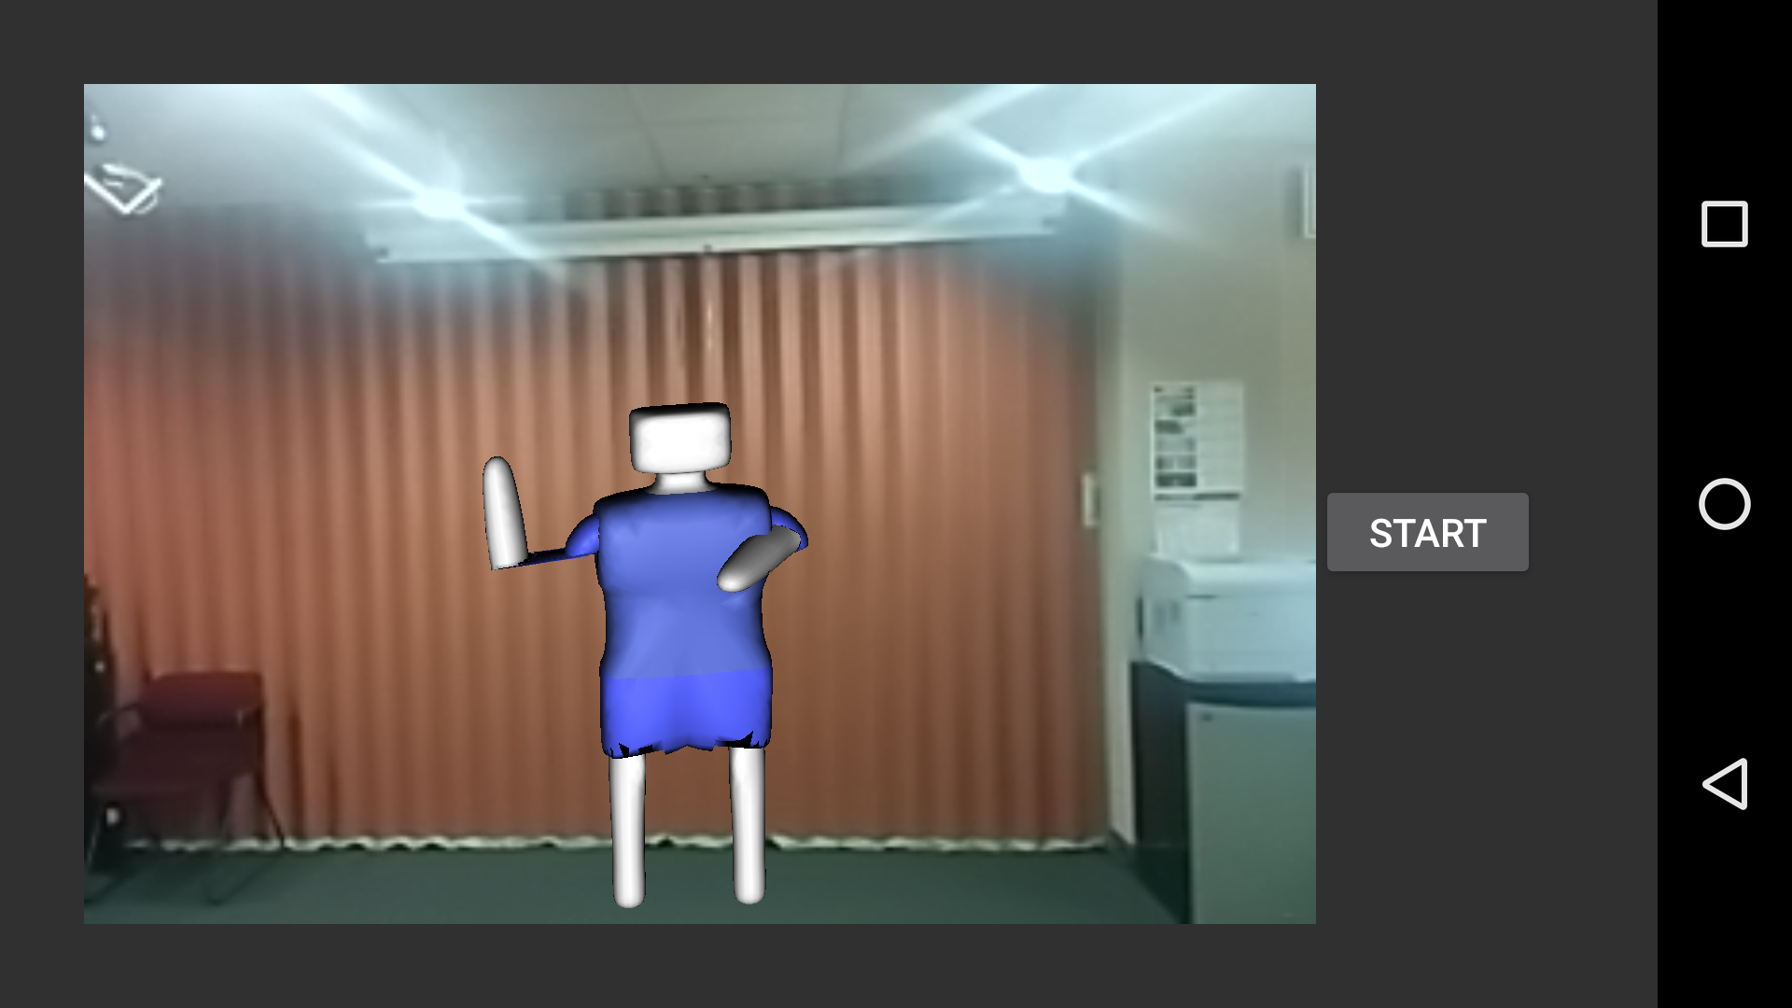
Multimedia data
Notes:
My resarch is about extreme compression on a variety types of data in systems with special hardware including binary and color iamges, videos and 3D object motion data
TODO
http://www.cruzine.com/2011/01/31/animated-gifs/

Slide 3
Standard video compression methods have limitations
64
64
64
64
~ 1000 Bytes
Larger data size
Notes:
TODO: [Consider using a different image]
For images, we have all kinds of compression technologies including … / … and … to reduce the data size,
But all common compressions method, on a 64x64 image, using the lowest quality setting, the smallest compressed file size you can get is about 1000 bytes,
To the best of our knowledge, no one has considered design color image compression method to compress data below 1000 bytes.

Slide 4






Motivating example
Store image data into Bluetooth low energy Beacons (30 bytes storage)
http://www.sierraclub.org/sierra/activism/saving-wild-places?page=7
Notes:
It is meaningful to consider the problem because …
a person doing hiking can put custom graphical navigation
info
a beacon attached to camera can work as long lifetime survelliance broadcasting system without human intervention

Slide 5
Problem of interest
For systems with limited storage, conventional techniques sometimes fail to provide sufficient multimedia data compression.
Develop a new approach to achieve better multimedia data compression than conventional compression techniques.
5
Notes:
TODO: [Consider using a different image]
So the problem of interest of my research is …
The goal is to ///

Slide 6
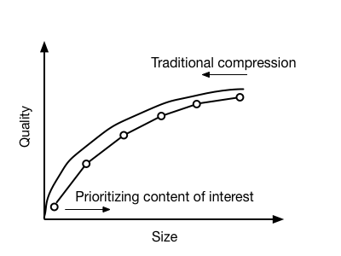
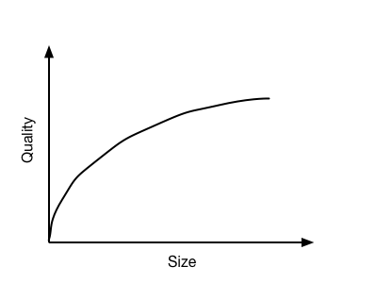
Approach
Notes:
Even though the question in two given examples look different, they can be addressed in the same way
The basic idea of my approach is shown in the plot
instead of following the traditional compression method that reduces the amount of information in the input data,
We construct the compressed data by prioritizing the content of interest.
Then we can have a new formula the data size of the compression

Slide 7
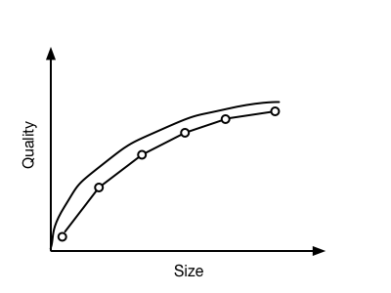
Approach
Notes:
Even though the question in two given examples look different, they can be addressed in the same way
The basic idea of my approach is shown in the plot
instead of following the traditional compression method that reduces the amount of information in the input data,
We construct the compressed data by prioritizing the content of interest.
Then we can have a new formula the data size of the compression

Slide 8
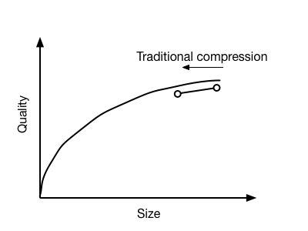
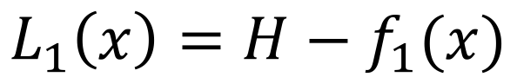
Approach
Traditional:
$$L_{1}\left(x\right)=H−f_{1}(x)$$
Original information
Information to reduce
Notes:
Even though the question in two given examples look different, they can be addressed in the same way
The basic idea of my approach is shown in the plot
instead of following the traditional compression method that reduces the amount of information in the input data,
We construct the compressed data by prioritizing the content of interest.
Then we can have a new formula the data size of the compression

Slide 9
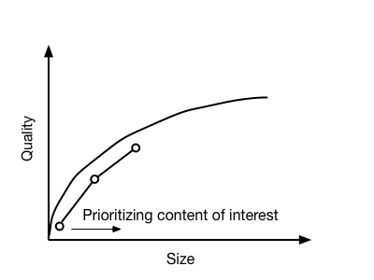
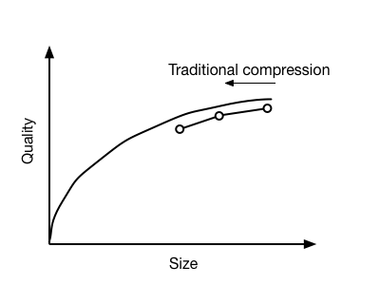
Approach
Traditional:
$$L_{1}\left(x\right)=H−f_{1}(x)$$
Original information
Information to reduce
Notes:
Even though the question in two given examples look different, they can be addressed in the same way
The basic idea of my approach is shown in the plot
instead of following the traditional compression method that reduces the amount of information in the input data,
We construct the compressed data by prioritizing the content of interest.
Then we can have a new formula the data size of the compression

Slide 10
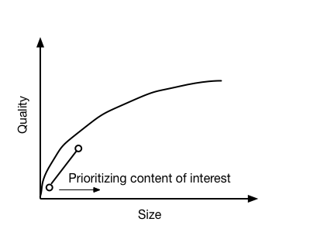
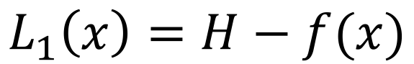
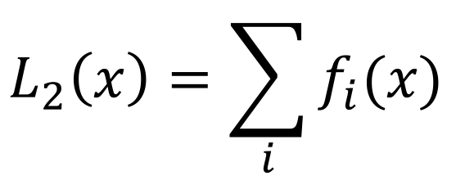
Approach
Traditional:
New:
$$L_{1}\left(x\right)=H−f(x)$$
Original information
Information to reduce
$$L_{2}\left(x\right)={\sum_{i}{f_{i}(x)}}_{ }$$
Information to keep
Notes:
Even though the question in two given examples look different, they can be addressed in the same way
The basic idea of my approach is shown in the plot
instead of following the traditional compression method that reduces the amount of information in the input data,
We construct the compressed data by prioritizing the content of interest.
Then we can have a new formula the data size of the compression

Slide 11
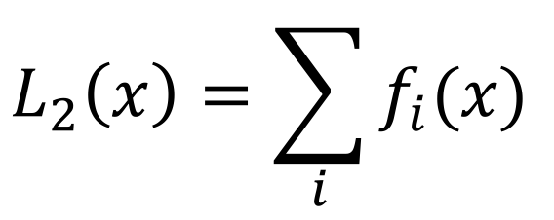
Approach
Traditional:
New:
$$L_{1}\left(x\right)=H−f(x)$$
Original information
Information to reduce
$$L_{2}\left(x\right)={\sum_{i}{f_{i}(x)}}_{ }$$
Information to keep
Notes:
Even though the question in two given examples look different, they can be addressed in the same way
The basic idea of my approach is shown in the plot
instead of following the traditional compression method that reduces the amount of information in the input data,
We construct the compressed data by prioritizing the content of interest.
Then we can have a new formula the data size of the compression

Slide 12
Approach
Traditional:
New:
$$L_{1}\left(x\right)=H−f(x)$$
Original information
Information to reduce
$$L_{2}\left(x\right)={\sum_{i}{f_{i}(x)}}_{ }$$
Information to keep
Notes:
TODO: before this slide, need to mention previous work: sift, region of interest
Even though the question in two given examples look different, they can be addressed in the same way
The basic idea of my approach is shown in the plot
instead of following the traditional compression method that reduces the amount of information in the input data,
We construct the compressed data by prioritizing the content of interest.
Then we can have a new formula the data size of the compression

Slide 13
Research statement
Prioritizing the content of interest in systems with extreme storage limit and quality requirement leads to new compression algorithms that give better compression than standard methods with the same quality compressed data for the application.
Better compression: image 200 bytes, video: 100x
Same quality: SSIM / analysis-based measurement
Notes:
Therefore my thesis statement is:
[I looked into the systems I worked on and find out the type of system where new compression works better is when why traditional compression techniques does not work efficiently,
The reason is that there are mismatches exist in the systems, for example … ]

Slide 14

Image
Notes:
My resarch is about extreme compression on a variety types of data in systems with special hardware including binary and color iamges, videos and 3D object motion data
http://www.cruzine.com/2011/01/31/animated-gifs/

Slide 15
Image: problem statement
Seek an image compression that can achieve < 1000 bytes compression
The compressed image should have sufficient quality (SSIM number comparable to JPEG compressed image)
We can have a pre-knowledge on image type (image with foreground object, etc. )
Notes:
My resarch is about extreme compression on a variety types of data in systems with special hardware including binary and color iamges, videos and 3D object motion data
http://www.cruzine.com/2011/01/31/animated-gifs/

Slide 16



Application: BLE Beacon technology
StickNFind
Qualcomm Gimbal
RedBear Beacon B1
Estimote
GeLo
KST Particle
Devices that broadcast small pack of data to nearby portable electronic devices.
Protocol designed to enable devices with low power consumption.
Only transmits small packets.
Long lifetime: 3~5 years
http://blog.estimote.com/post/57087851702/preorder-for-estimote-beacons-available-shipping
http://localz.com/blog/ibeacon-ble-hardware-commercial-comparison/
Notes:
Firstly briefly go over what is a BLE beacon
Devices broadast data using Bluetooth low energy protocol
Upper level protocol build upon it

Slide 17
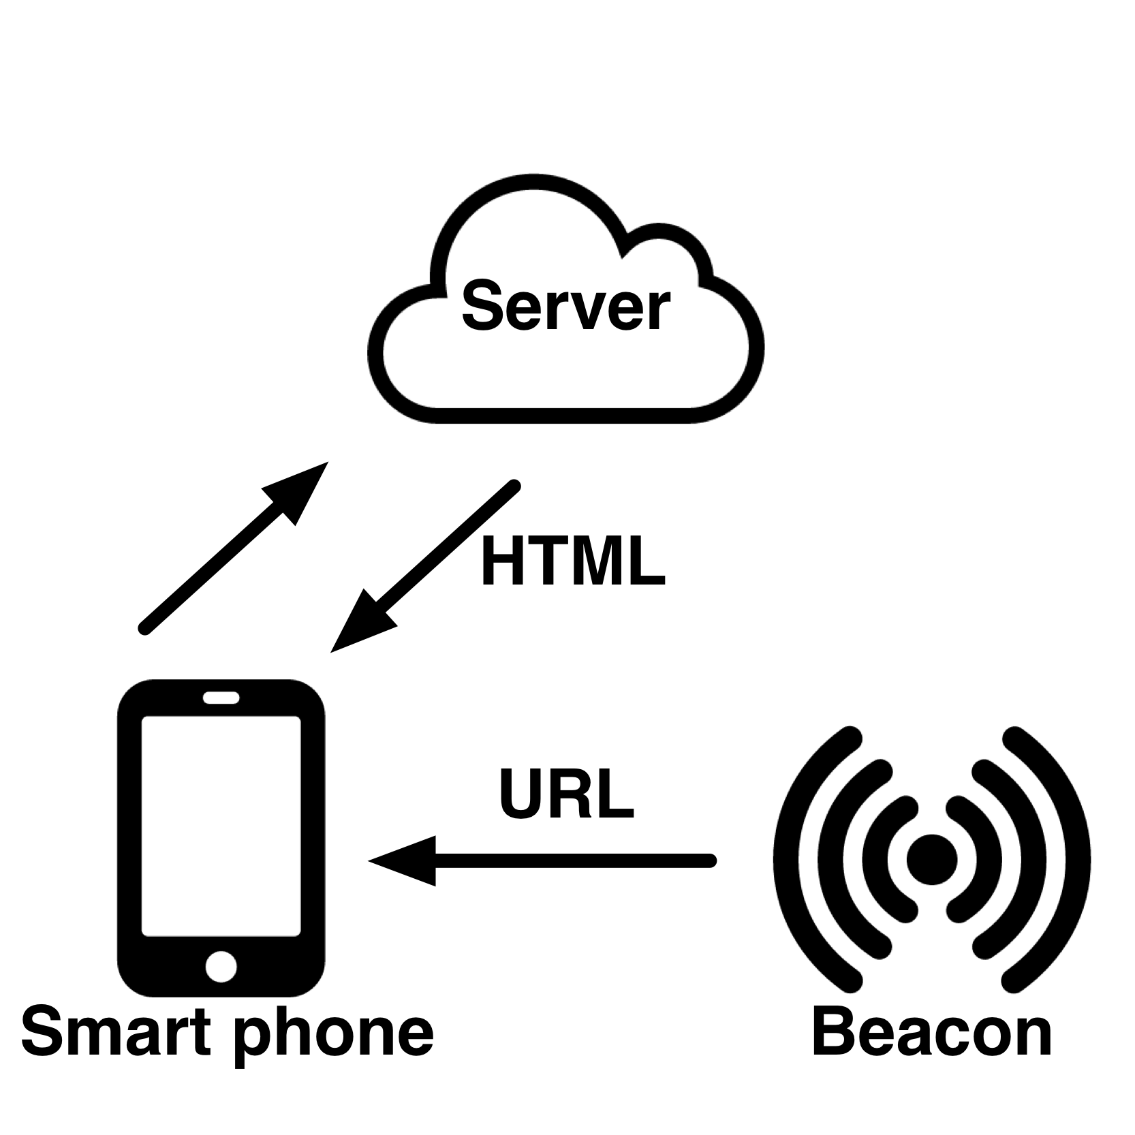
Special hardware (example: BLE Beacon)
Notes:
Involves spetial hardware including BLE beacons
A BLE beacon (shown uppler right) is a battery powered hardware broadcasting small packet of data to nearby mobile devices,
usually it is an URL, as a content location info, and the mobile devices get the actual contnet from internet

Slide 18

Background: BLE Beacon technology application
http://prismdevkit.com/lesson-8-an-intro-to-estimote-beacons/
Notes:
Shows typical use case
System briefly knows where you are
-This technology enables applications in several domains including ….
-serie of Use cases:
Customer can get advertisements in the entrance, do automatic checkin and rewarded with coupons,
With indoor location feature, the beacon delivers to cumster the information of the products that are close to the customter,
They can even do smooth checkout withit
Customer behavior analysis: Pierdicca et al. (2015)
Indoor localization: Martin et al. (2014)
Room occupancy detection: Conte et al. (2014)

Slide 19
Why store multimedia data into beacon devices?
Google Physical Web, Fat Beacon
Beacon deployment for places without Internet connection
Notes:
Our goal is to have a different usage of the beacon devices
Why we need to ..?
Since there is plan to make beacons more powerful, Google is working on the concept of Fat beacon store broadcast webpages, as part of the physical web project,
Multimedia contensts such as Images can be an important part of a webpage
While we want to deploy beacons into places without internet connection, and we want to broadcast multimedia data, for example, shown in the early part of the talk, outdoor survelliance

Slide 20

Challenge: Battery Life constraint
Notes:
This work is in the area of real time system and internet of things. In the real time system and internet of things community, the most important evaluation metric is energy consumption and execution time.
Then the challenge of storing large size data into BLE beacons can be explained by this plot of battery lifetime versus advertising interval.
, for a large trunk of data, even though we can let beacon to broadcast part of the data in one period,
The beacon broadcast frequency has impact on beacon battery life,
For too large data size, we either have to wait for a long time, or we have to sacrifice beacon battery lifetime
https://files.readme.io/m5rzEic2TcyB3k1HLrQw_beacon_energy_consumption.png

Slide 21
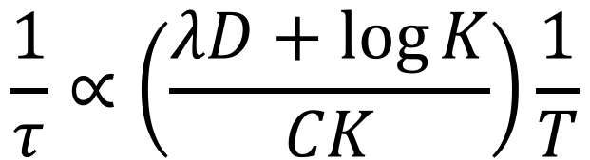
Challenge: Battery Life constraint
D: data size
λ: compression
C: payload size of BLE packet
T: maximum allowable latency
K: number of beacons
𝜏: beacon lifetime
$$\frac{1}{τ}∝\left(\frac{λD+\log{K}}{CK}\right)\frac{1}{T}$$
Notes:
We have this formulated as, when the allowable latency for the data delivery is fixed, the beacon lifetime is propotional to the number of beacons we use, and beacon payload size, and inverse propertional to the given data size.

Slide 22

Challenge: BLE packet format
iBeacon packet format
http://www.argenox.com/bluetooth-low-energy-ble-v4-0-development/library/a-ble-advertising-primer/
Limited broadcasting data packet size
4 Bytes in iBeacon mode (UUID is not changeable via API)
18 Bytes using Eddystone URL mode
30 bytes using BLE lower level protocol
Future: BLE 5.0 with 8x broadcasting capacity: ~256 bytes
-> We must compress the data
Notes:
The other side of the challenge is that the beacon packet format limits the data size to be 30 bytes, which means that we need many broadcasting cycles for 1000 bytes data

Slide 23






Challenge: traditional compression is not good enough
For the 64x64 “Lena” image:
Default quality
8549 Bytes
Quantization
level 20
1077 Bytes
Default quality
1382 Bytes
Quantization
Level 20
732 Bytes
Simple threshold
637 Bytes
Canny
1268 Bytes
Beacon broadcasting power: -10 dBm
broadcasting interval: 500ms
Need image delivered in 1s
JPEG:
Lifetime 5 years -> need 20 beacons
Use 4 beacons -> lifetime 1 year
Using our method:
Lifetime 5 years -> need 3 beacons
Use 4 beacons -> lifetime 7 year
Chain
Coding:
427 Bytes
Notes:
JPEG is about tranferring signal into freq space and downsampling
Quantization is like downsampling in frequency space
What else is there besides JPEG? Backup slide ready for that.
Cite state of art color image compression codec
Tree-based image compression paper

Slide 24
Prioritizing content of interest
Idea: having a notion of foreground / background
Previous work
Application aware surveillance video compression [Minervini, et al. 2013]
Visual feature preserving image and video compression. [Chao et al., 2016]
Object-based surveillance video compression [Makur et al. 2006]
We are the first in applying prioritizing content of interest to give 64x64 compressed image size < 200 bytes
Notes:
JPEG is about tranferring signal into freq space and downsampling
Quantization is like downsampling in frequency space
What else is there besides JPEG? Backup slide ready for that.
Cite state of art color image compression codec
Tree-based image compression paper

Slide 25

System Contribution and Benefits
First image storage and broadcasting based on BLE beacons
Benefits:
Low cost
Internet-free
Long lifetime
Battery powered, 5 years
Easy to deploy
Some buildings already have BLE beacons deployed
Notes:
I did another example in using ble beacons for incdoor agumented reality
The sytem wroks in two phases
In capture phase, the object of interest is captured by the camera placed in the room, the motion data is recoreedd and sostred in the beacons
Then in the render phase, a reviewr can use a mobile phone or tablet to receive the data from beacon and watch the virtual object rendered in the scene

Slide 26



Color image: approach
[IoTDI’ 2017]
Foreground, adaptive encoding:
DCT
Wavelet
Triangle mesh
Background:
Down sample -> DCT
Notes:
Region of interest: foregorund / background
Allocate more bits describe the foreground
Still needs to preserve the background to give some context info

Slide 27
Segmentation
Generating an accurate segmentation
Apply the best encoding method for foreground region
Notes:
Single image-based, segmentaiton, such as watershed based method some times are not accurate,
Depth based method requires multiple view caputre, tends to be noisy
Combine the two results
Here: use the road sign as example, replace the mug

Slide 28
System
Multi-view capture
How to find a good pair of images?
-> Use IMU signal
Generate depth information
Compress foreground and background separately
Generate segmentation
Notes:
Here we have another optimization here: the good pair of images may not be easy to find: the user may need to try many times.
We design and implemented a IMU guided capture

Slide 29

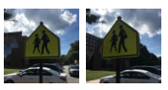
IMU-guided multi-view capture
Record phone sensor (IMU) readings when capturing multiple views
Train a decision tree model
Use the model and IMU reading to predict the good pair of images
①
②
③
IMU 0
IMU 1
IMU 2
IMU 3
…
…
Capture IMU reading
Predict good time for capturing
Train model
Notes:
Reduce the time of find a good pair of images,
Training phase, we record the sensor data, labeled each one by the depth map qualty
Train decision tree model
Use to predicdt the good pair of iamges

Slide 30
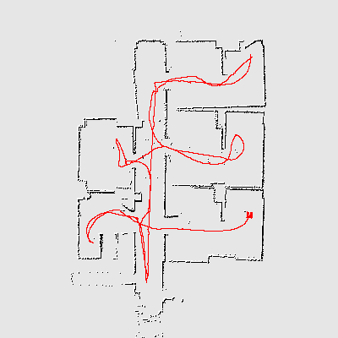
A widely-applicable multi-view capture optimization
Can be applied to any systems that involves real-time multiple view capture and depth estimation
Obstacle avoidance
Simultaneous localization and mapping
http://hrl.informatik.uni-freiburg.de/icra13ws/pics/cover-octomap-2.png
http://www.societyofrobots.com/images/sensors_IRSLAM.gif
Notes:
We need to store visual feature data into beacons, to reduce the data size, we only select the subset of the visual feature. Detected. IN the selection, we consider the two factors, the entropy of the feature and the location of the feature in the image. We prefer visual feature with high entropy and more close to the center of the scene, the reason for the first factor is that we want to reduce the chance of mismatch, the reason for the second factor is that the image being matched is usually shoot in the same scene as the reference image

Slide 31
Image encoding
Reduce frequency component coefficients / quantization
Reduce mesh density
Notes:
Foreground and background processed separately
We would like to control the size/quality of the foreground, For DCT wavelet, reducing the frequency compoent coeffs, for triangulariztio, we can reduce mesh desity

Slide 32
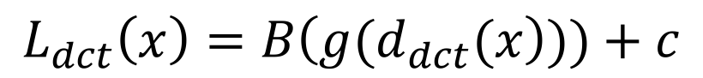
Data size
$$L_{dct}\left(x\right)=B\left(g(d_{dct}(x\right)))+c$$
Required bit length for encoding foreground in DCT
Required bit length for encoding background
$$L_{wavelet}\left(x\right)=B\left(H(d_{wavelet}(x\right)))+c$$
Required bit length for encoding foreground in wavelet
Required bit length for encoding background
$$L_{mesh}\left(x\right)=B\left(g(v\left(x\right), n\left(x\right),i(x)\right)))+B(g\left(t\left(x\right)\right))+c$$
Required bit length for encoding vertices, texture index, connections
Required bit length for encoding the texture
Required bit length for encoding background
Notes:
Gzip: LZ77, dictionary based compression
For different encoding method, the formula is different, and they all follows the framework of contructing the data from the content of interest

Slide 33
Evaluation
Notes:
I built a test set of images that covers both indoor and outdoor images, including road signs, buildings, indoor / outdoor bojects

Slide 34
Evaluation
Notes:
Green color curve: jpeg, Beat jpeg again

Slide 35


Evaluation (user study)
Recognize objects
Notes:
We take a image on an object in the lab, compresed it, and mix the object with similar objects,
Then we ask the participant to look at compressed image. guess which one it is,
We repeat the experient with 4 group of objects,
And record the correct guesses
Orange dashed line shows the correct rate of making a random guess, which is 33% percent
For the higher storage space, we allow higher quiality images, imporves the chance of correct guess
Object with spatial tetxure is easy to recoginize

Slide 36
Binary image compression
If the input image is binary
Systems with user interface that supports drawing, handwritten symbols
Application: navigation, simple custom message
A patch-based method performs better
Notes:
Some times we want to have systems that only store binary images, this is linked to a variety of sytems …
Applications include
For the case ethat input image is binary,
We have an alternative approach

Slide 37


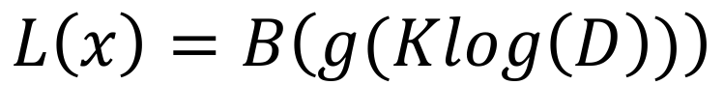
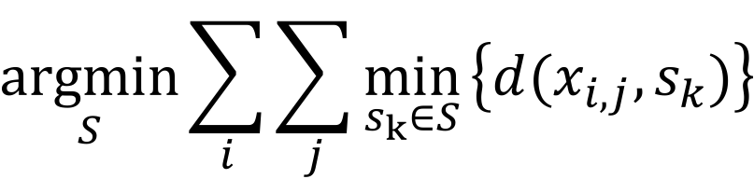
Binary image: patch-based compression can do better
Set of spiral patches derived from K-means clustering
$$\underset{S}{argmin}{\sum_{i}{\sum_{j}{\min_{s_{k}∈S}}}\left\{d(x_{i,j}, s_{k})\right\}}$$
Image size:
$$L\left(x\right)=B\left(g(Klog\left(D\right))\right)$$
[DCOSS’ 2016]
Number of patches
Patch bank size
Notes:
Why binary image:
Symbols, hand written digits, custom navigation information
Majorlly contains curves, patch-based compressoin can do better

Slide 38


Compression result
16 64 256 1024 4096
Image Size (Bytes)
Notes:
Morphology: small island removed, connected component enhanced
Using a very trivial encoding: store all indices, the compression ratio is already very good
This plot comparison between our method and JPEG
In some areas, you can have some images what my method works better than jpeg: better quality and lower size.
Blue: you need around half a dozen or two dozen
Red: 2 or four beacons

Slide 39








Navigation test
5 participants
Notes:
-Goal: simulated remote navigation / hiking system
-5 participants
It has an animation!!!!!
- deployed 6 beacons with navigation information in 6 locations in the building’2 and 3 floor
- follow the iamges from xx to xx, displayed on the screen
- route like this
- Free to give up
Finally we ask their idea of the clearness of the signs
－ 4 of 5 participants successfully completed the route,
1 gave up because of xxx
This drags down the user’s subjective socre of image 3
we believe with more careful deploying, the technology can be useful in customized navigation without internet connection
http://cs.unc.edu/files/2013/12/brooksbuildingsmall.jpg

Slide 40
Contributions (multimedia data compression for BLE)
Novelty:
Enable long lifetime multimedia data storage/broadcasting on battery powered systems with extreme memory/bandwidth limit.
First BLE image broadcasting system
IMU-guided multi-view capture algorithm
Designed adaptive image encoding method for this system
Generality:
IMU-guided multi-view capture algorithm can be applied in other multi-view capture systems
Notes:
The contribution of this part of my research is that I built the first system for storing / broadcasting xxx, first … and first …
Algorithmwise, I designed the new visual feature selection algoirthm and IMU guided multi-view catpure algorithm

Slide 41
Video
Notes:
My resarch is about extreme compression on a variety types of data in systems with special hardware including binary and color iamges, videos and 3D object motion data
http://www.cruzine.com/2011/01/31/animated-gifs/

Slide 42
Video: problem statement
Standard compression technique (H.264, H.265, VP9) can achieve 100x compression but the video quality does not fulfill the application requirement
Seek an video compression that can achieve 100x compression while the compressed video quality fulfills the application requirement
Notes:
My resarch is about extreme compression on a variety types of data in systems with special hardware including binary and color iamges, videos and 3D object motion data
http://www.cruzine.com/2011/01/31/animated-gifs/

Slide 43


Application: microscopy video compression
High throughput microscope
Storage
Analysis program
Problem: increase in the amount of video data is faster than the increase in affordable data storage.
http://cismm.cs.unc.edu/core-projects/force-microscopy/high-throughput-microscopy/
Notes:
Mordern Microscopy systems with multiple channels that can generate multiple high resolution videos in short time
The system shown in the right is a 12 channel microscope in. the physics department, can generate 1TB video in a hour
The problem in the system is

Slide 44
Analysis-preserving Video Compression
Require that the compression has no impact on analysis – analysis-preserving
Most popular video compression H.264 in lossless mode:
yields the compressed data in the size of 49.74% of the original one
-> 1TB / hour data: need too many disks for the data storage
-> Our new analysis-preserving compression gives: 7.26%
-> Best case: 0.7729% vs. 19.4505%
Notes:
This shows a sample video,
The constraint on the video compression is that,
Standard ... cannot be used as when it is set to lossless mode, the compression ratio is not high enough for the system

Slide 45
Approach
Store only the information in a video that analysis can use
Separate every frame into foreground (pixels that carry information) and background (pixels that do not change throughout the video).
Average out noise in the background. -> easy to compress
Losslessly compresses the foreground regions
[Microscopy Research and Techniques 2015]
Notes:
The approach is …
Generate a new video by replacing every background pixel by its average value over time,
Compress the new video using standard lossless techniques
Since many of the pixels are constant over time in the new video, it will be easier to compress
The question left is How to tell a pixel F/B?

Slide 46

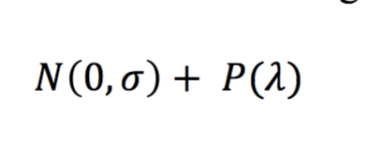
Key Observation
1. In the microscope image formation process, convolution with the point-spread function spreads image brightness changes in one pixel to its neighbors.
-> neighboring foreground pixels’ intensity over time values are correlated
2. The noise is independent between neighboring pixels.
http://en.wikipedia.org/wiki/Point_spread_function
Notes:
For identify foreground,
We can make use these two properties in a microscopy video
Foregorund pixel is after the convolution
->
Background only contains noise, can be modeld by a a Gaussian and poisson distributin, parameterized by two numbrs

Slide 47
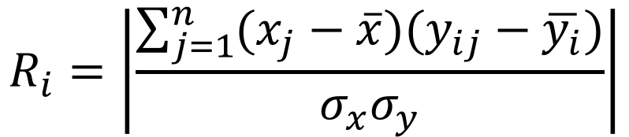
Foreground / background separation
Pearson’s correlation over time
$$R_{i}=\left|\frac{\sum_{j=1}^{n}{(x_{j}−\overline{x})(y_{ij}−\overline{y_{i}})}}{σ_{x}σ_{y}}\right|$$
High score: foreground
Notes:
We can use correlation for segmentation
compute the correlation score of everypixel and its adjacent pixels over time
We take the mangnitude of the eight correltaion values,
And use the largest one as the score assigned to the center pixel
Higher score will suggest that it is foreground

Slide 48
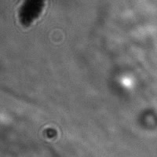
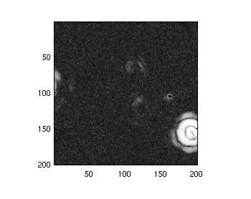
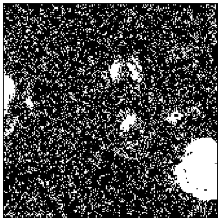
Foreground / background separation
Video
Plot of scores
Binary map
Notes:
We can do some thresholding on the scores to generate a binary map with the white region indicating the foregrounds

Slide 49
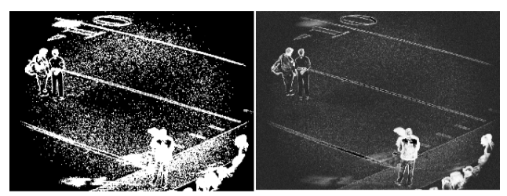
A widely-applicable video frame segmentation method
Correlation-based segmentation can also be applied to other types of video taken by imaging devices including microscopes, telescopes, and other cameras where the object is not perfectly in focus
Plot of scores
Binary map
Notes:
TODO: better shows the original video

Slide 50
Refine the result: Key Observation
1. the noise is independent between neighboring pixels
2. convolution with the point-spread function present in the microscope image formation process spreads image brightness changes in one pixel to its neighbors.
-> Small “islands” should not be foreground, remove
Notes:
Tends to be noisy, we add a refinement stage to clean it up
The reasoning behind that is that
Because we know the existing of point spread function is larger than 2 pixels
and the noise is independent between neighboring pixels
Which means that, in the binary map, the small while islands of one or two pixels should not be foregound and they should be removed

Slide 51
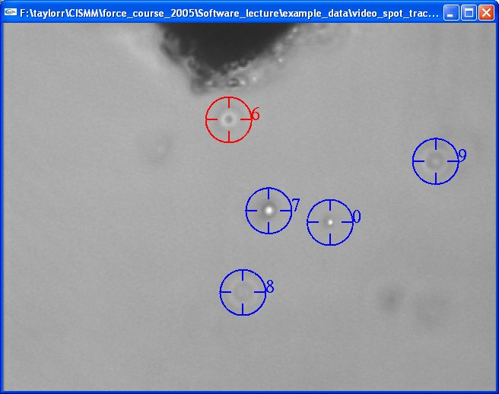
Video Spot Tracker
Notes:
Also we would like to include some background, for application purpose.
In doing analysis on the object movement, we use the software video spot tracker
The software tracks the object by placing a tracker centered at the object
The tracking analysis does not only take the foreground pixels into account, also some background pixels inside the tracker

Slide 52


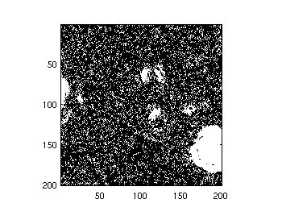
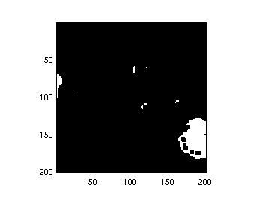
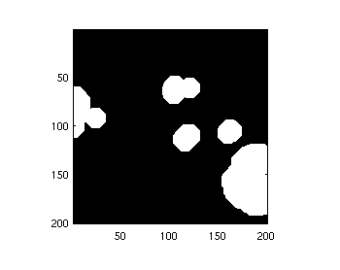
Refine the result Mathematical Morphology
erosion
dilation
3 x 3 pixels
Fit tracker size
Notes:
Given a binary map, we want to remove the small white regions, we use a erosion operation with operator size 3x3 pixels, which removes the white islands smaller than t3x3 pixels
After the erosion, we dilate the result using a dilation operator with the size fit the tracker size, which will expand the foreground regions, then all the pixels that the video spot tracker uses in analysis will be losslessly compressed

Slide 53

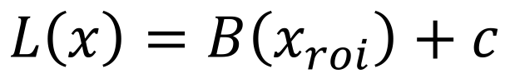
Overall approach
Video Size:
$$L\left(x\right)=B\left(x_{roi}\right)+c$$
Required bit length for lossless encoding foreground
Required bit length for encoding background
Notes:
This is shows the overall approach of the compression technique
Having the binary map, we refine it, we use the refined binary map to generate a new video which has background pixels replaced by their averages over time
This video will be better compressed than the original video, we can also run the analysis to the check if it has the same result as the original video
The video data bit length can be formulated as the required bit length for the foreground pixels and a small term for encoding the background.

Slide 54


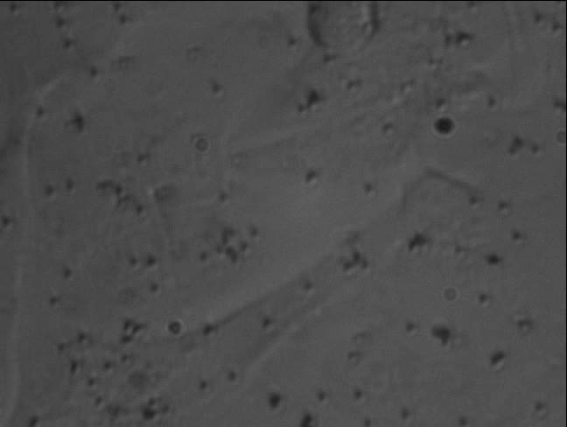
Experiments
Notes:
In evaluation my method, I used four videos, contains different number of beads and different lighting conditions

Slide 55
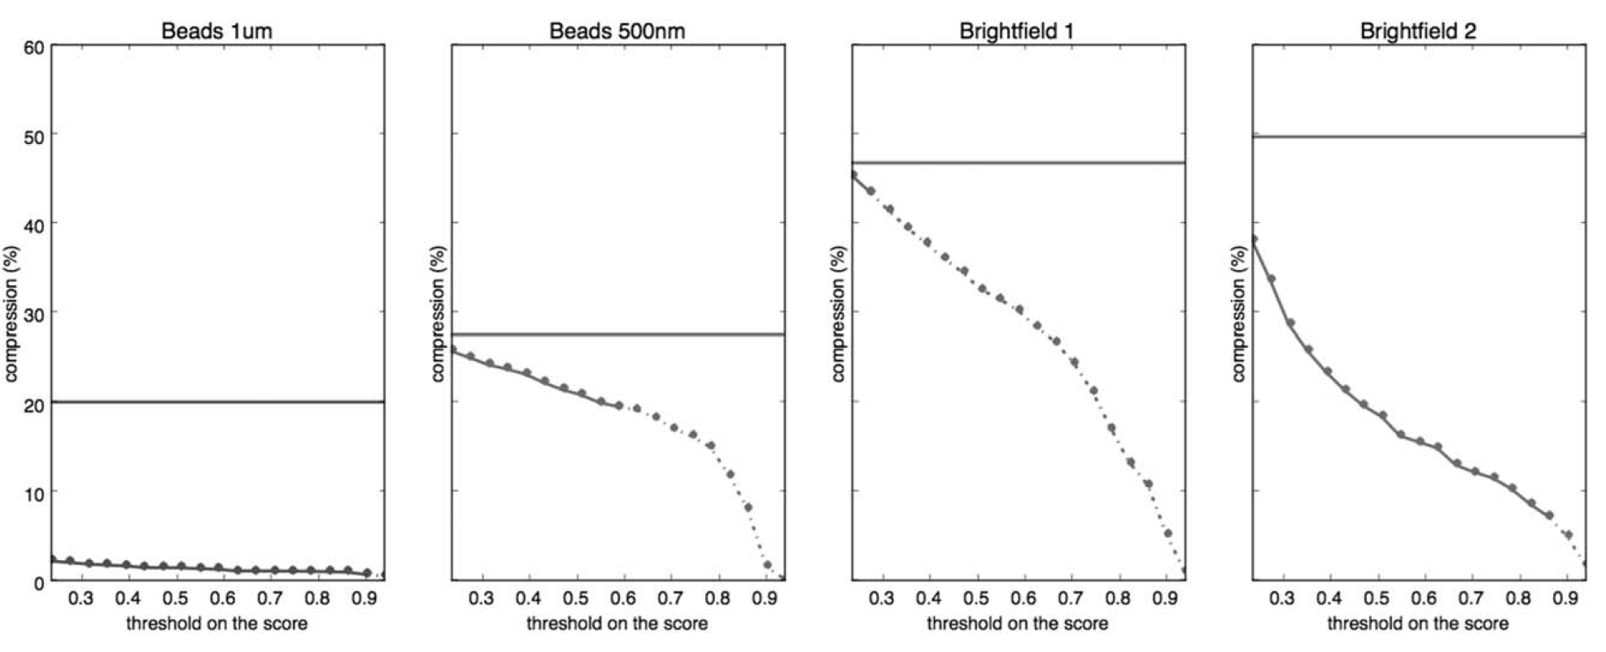
Results 1: compression ratio
compressed video size / original size
compressed video size / original size
compressed video size / original size
compressed video size / original size
threshold on the segmentation score
threshold on the segmentation score
threshold on the segmentation score
threshold on the segmentation score
Analysis-preserving
H.264 lossless mode
Notes:
TODO: this plot can come earlier
Horizontal axis: different threshold for segmentation used , Vertical axis, Horizontal lines, Dotted line
solid… means with this threshold, the compression has no impact on analysis
Lines in the same color means they are using the same video
In all four cases, our method always outperforms standard method,
Arrow: more than 100x

Slide 56
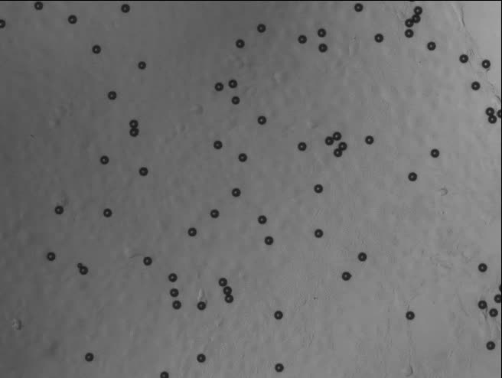
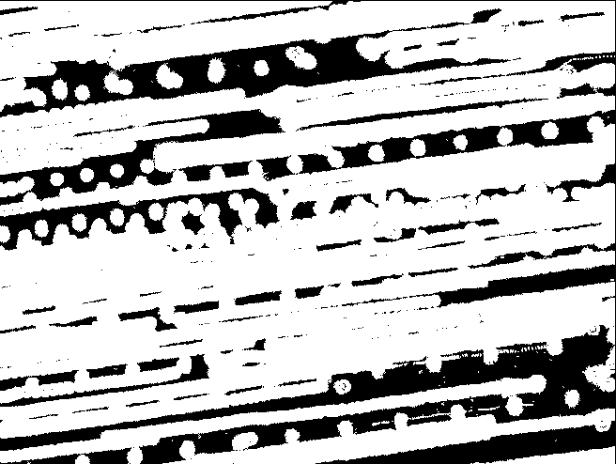
Quickly moving foreground objects
Notes:
In practice, we have videos that...
We have to label a pixel as foreground if is on the trajectory of the object movement, in total most of the pixels are marked as foreground

Slide 57
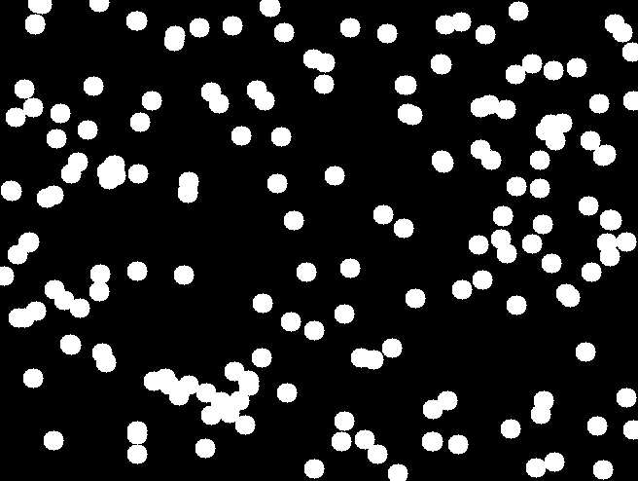

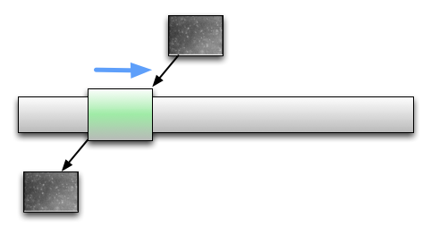
Sliding window
Notes:
To make our method works more efficiently on this type of video
We do the correlation analysis based on the frames in the windows
and store the frames based on the binary map generated in this analysis in the window
when the foreground objects stay static, we don’t have many pixels marked as foregound,
Gives us a chance to better compress the video
Question is size

Slide 58
Sliding window: window size
Notes:
Explain the table
You can expect the smaller window size is better than the larger one,
But the too small window size will make the background pixel average value keeps changing, this will make the result video to be harder to compress
Experiment shows that 10 frames window size gives the best compression result

Slide 59
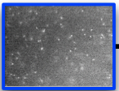
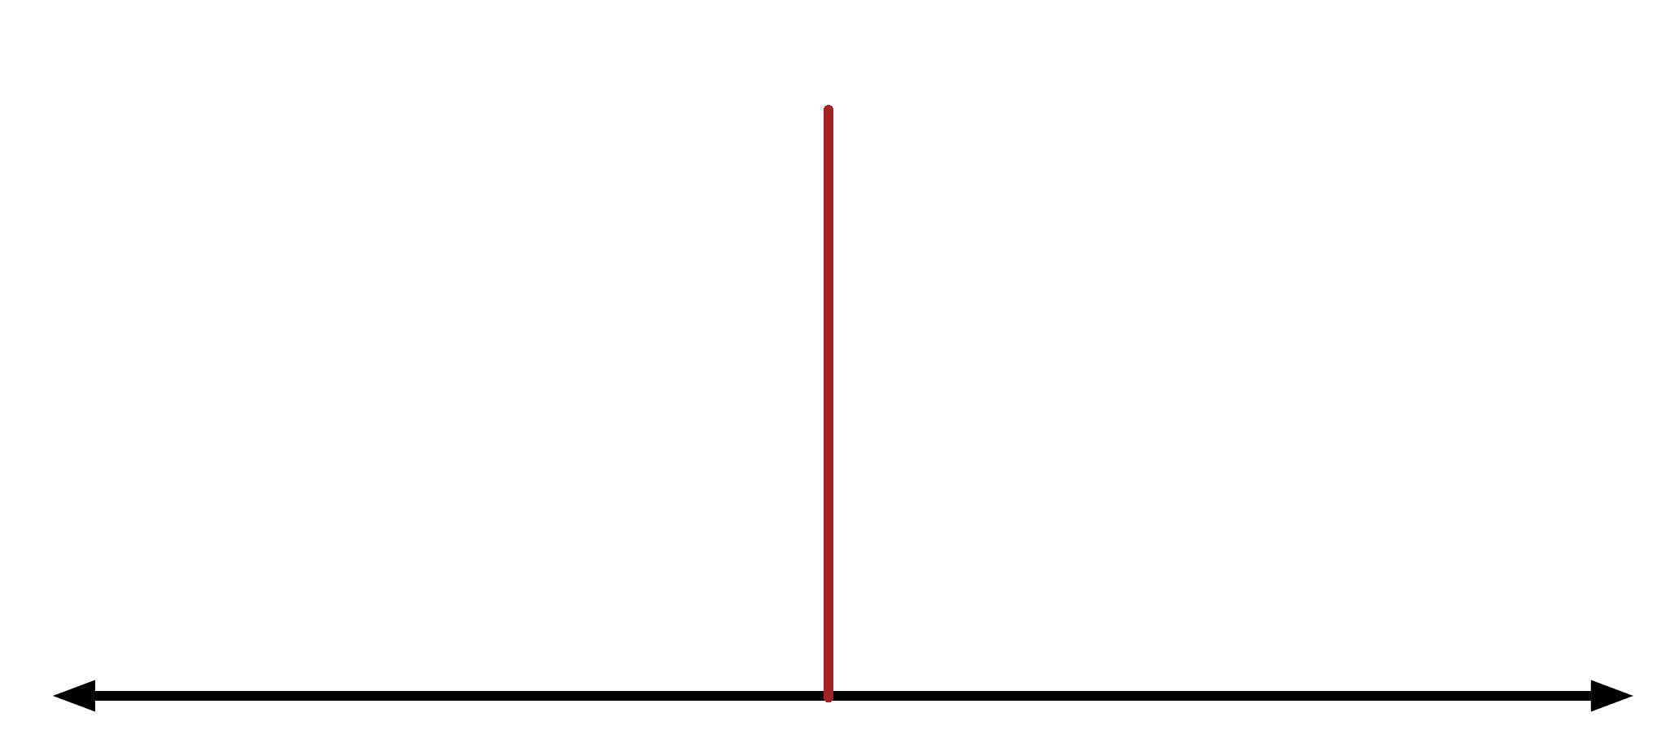
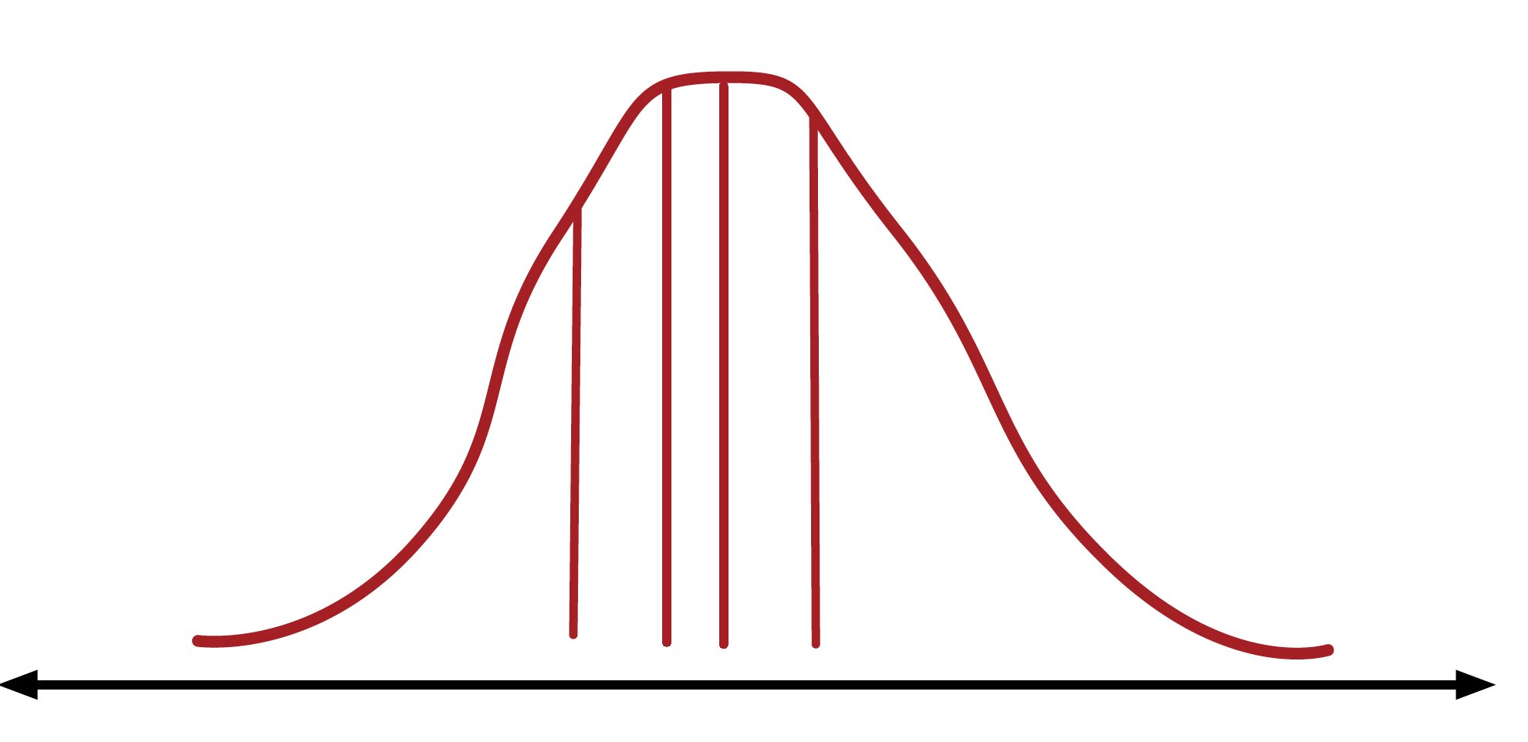
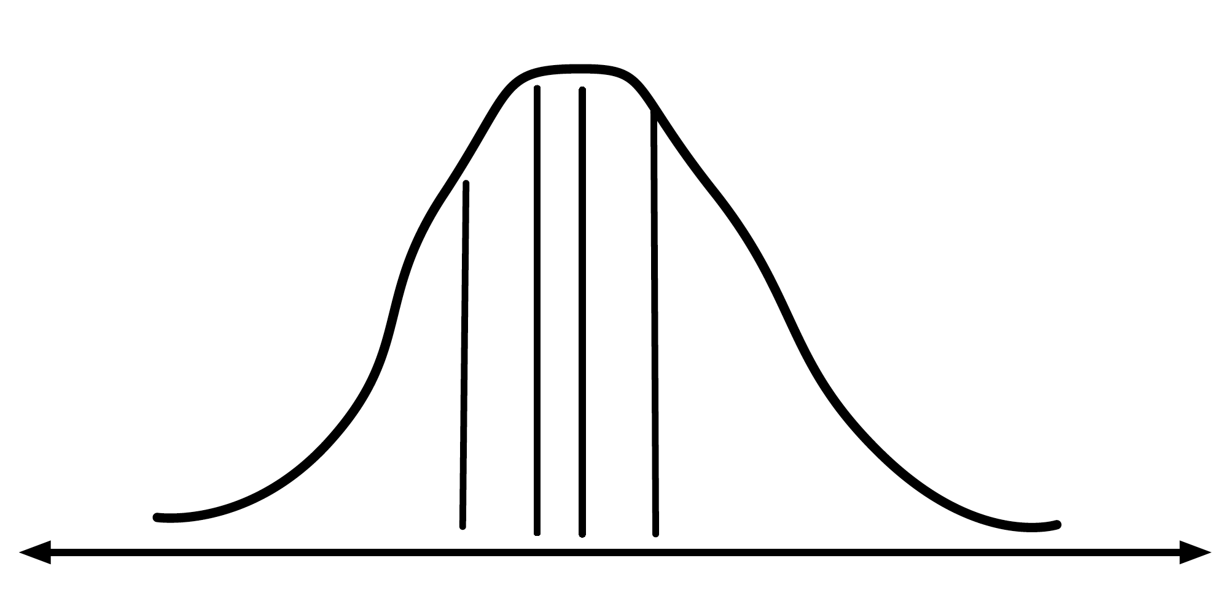
Analysis-preserving vs analysis-aware
The analysis result (vertical line) on the actual object motion is the ground truth
Analysis Result
Noise-free video
The actual video contains noise that makes the analysis result a random variable that follows a probability distribution
Analysis Result
Noise
Analysis Result
Noise-free video
Analysis Result
The analysis result on compressed video is also a random variable that follows a probability distribution
Same?
Analysis Result
Compression
Analysis Result
Noisy video
Analysis Result
[Microscopy Research and Techniques 2017] (under preparation)
Notes:
To understand this argument,
Firstly consider the analysis is about analyze object motion in the video
We claim that the compression is good when we have two sets of result statistically indistinguishable

Slide 60
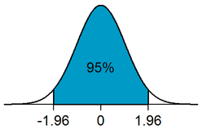
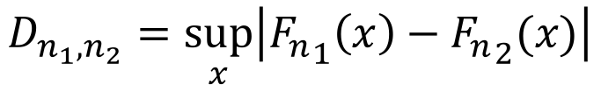
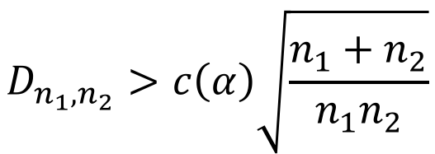
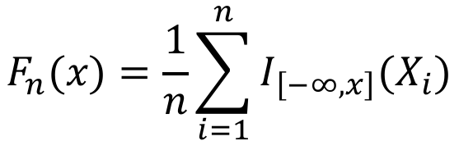
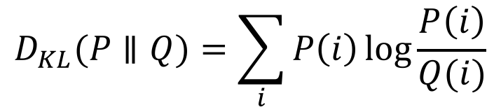
Analysis-aware compression
Two-sample Kolmogorov-Smirnov test (KS test)
Kullback-Leibler divergence (KL divergence)
$$F_{n}(x)=\frac{1}{n}\sum_{i=1}^{n}{I_{\left[−∞,x\right]}(X_{i})}$$
$$D_{n_{1},n_{2}}=\sup_{x}\left|{F_{n}}_{1}\left(x\right)−{F_{n}}_{2}(x)\right|$$
$$D_{n_{1},n_{2}}>c\left(α\right)\sqrt{\frac{n_{1}+n_{2}}{n_{1}n_{2}}}$$
Empirical distribution function
$$D_{KL}(P∥Q)=\sum_{i}{P\left(i\right)\log{\frac{P\left(i\right)}{Q(i)}}}$$
Notes:
In testing if two set of samples come from the same distribution, we uses two methods, KS test, and KL divergence
KS test measrues the suprmium on differnces two emprircal distributions functiosn for two set of sampels, two set of samples are considered from two distributions when Dnn > c(a) \sqrt(n+n’)/nn’
KL divergence tells the amount of information lost when Q is used to approximate P.

Slide 61
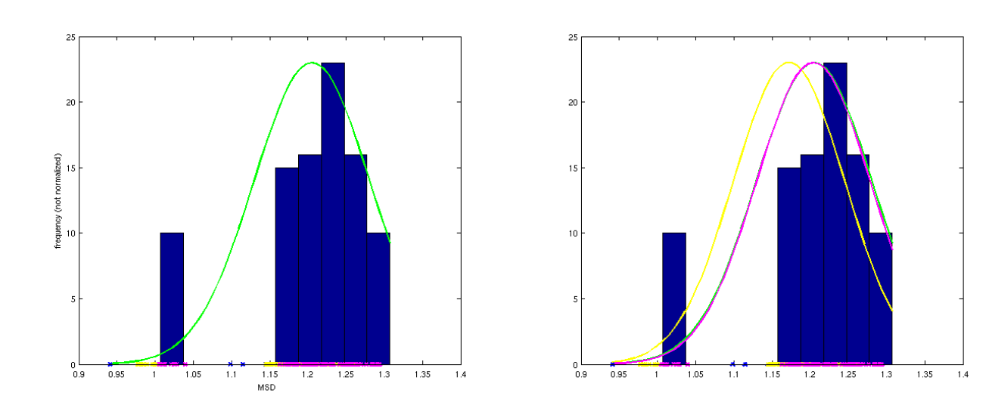
Add synthesized noise
uncompressed noisy video
compressed video
compressed video after adding synthesized noise
Notes:
Fitted distribution of analysis result

Slide 62
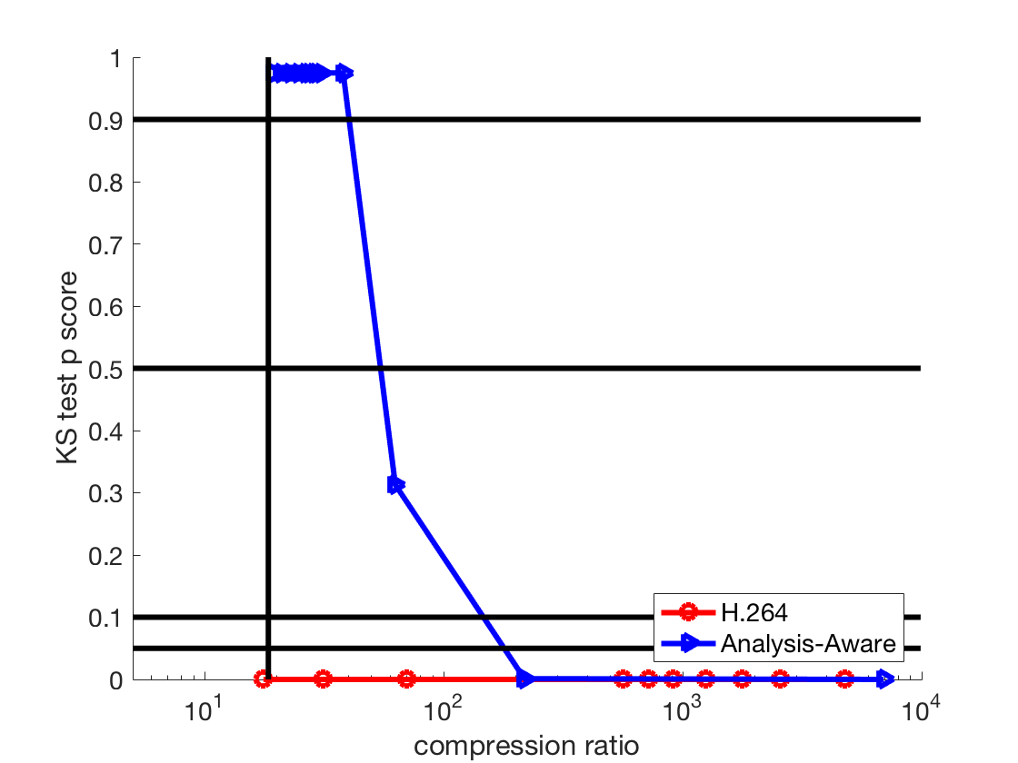
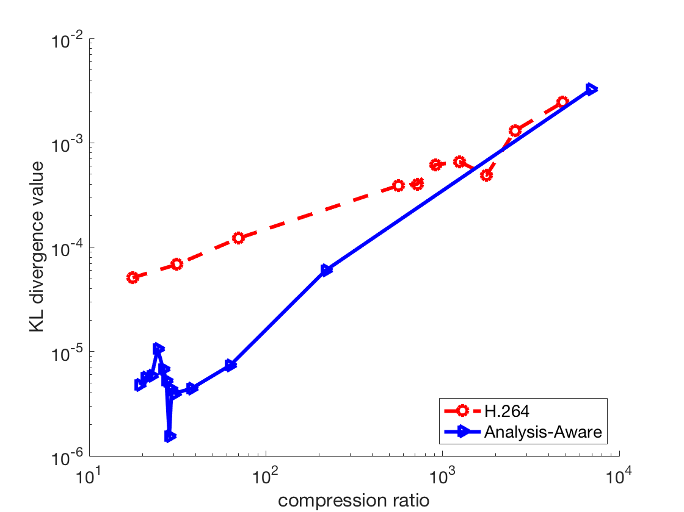
Evaluation (generated data)
Our previous approach: 19
Significance levels
41
55
149
178
KS test (higher score is better)
KL divergence (lower score is better)
Notes:
I implemented two versions of Analysis-aware compression, one reduces the video information by avaraging background pixels, second change H.264 codec to assign background low qulaity values. The expeirment also compares the result with and without adding synthesized noise as post-processing
Horizontal axis is ...
vertical axis is ...

Slide 63
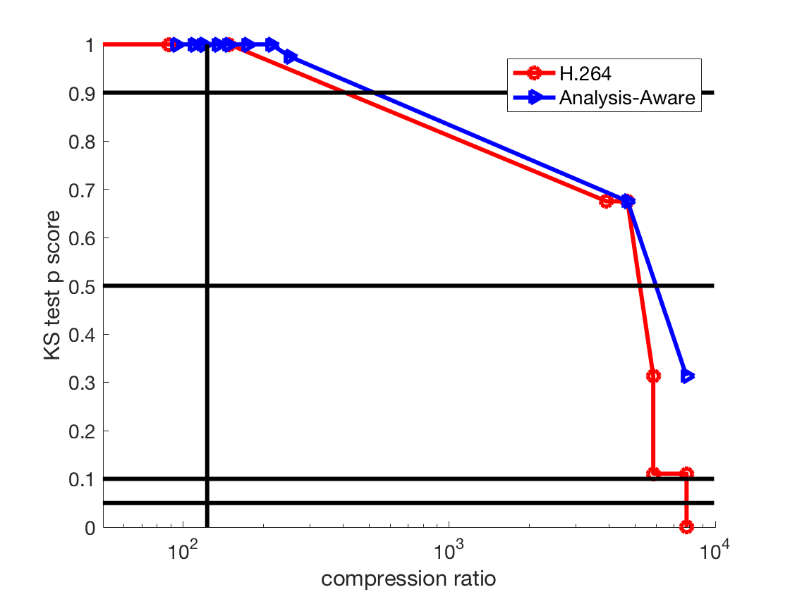

Evaluation (real video)
Our previous approach: 123
Significance levels
520
6000
KS test (higher score is better)
KL divergence (lower score is better)
Notes:
For the real video, H264 also works in the most of time, but from the right plot, we can see for small compression ratio, we get better result on our method

Slide 64
Method summary
Compression method based on correlation followed by mathematical morphology can give at most 100x compression
Extension: sliding window
Analysis-aware compression evaluates microscopy video quality using statistical tests
Enables even higher compression ratio

Slide 65
Contributions (video compression)
Novelty:
A microscopy video compression with 100x compression ratio
The first video compression technique in the literature that is based on correlation
A correlation-based video frame segmentation technique based on point spread function
A new way to evaluate the quality of a microscopy video based on statistical test
Notes:
The contribution of this work includes
The invented segmentation method can be generalized to …

Slide 66
Contributions (video compression)
Generality:
Correlation based segmentation can be applied to imaging devices including microscopes, telescopes, and other cameras where the object is not perfectly in focus
Adding synthesized noise to make the compressed video better match the original can be applied to videos other than microscopy.
Plot of scores
Binary map
Notes:
The contribution of this work includes
The invented segmentation method can be generalized to …

Slide 67
3D moving object
Notes:
My resarch is about extreme compression on a variety types of data in systems with special hardware including binary and color iamges, videos and 3D object motion data
http://www.cruzine.com/2011/01/31/animated-gifs/

Slide 68
3D moving object: problem statement
Current state-of-art indoor AR system is expensive (Hololens, $3000), system lifetime is short (~5.5 hours)
Since BLE beacon is cheap ($20 each) and has long-lifetime (~5 years)…
Can we compress and store 3D object motion data in BLE beacons and build an indoor AR system?
Notes:
The problem statement of this part of my research is
Looking at the current state of art …

Slide 69

MARBLE: 3D surveillance data compression + AR
[SenSys’ 17] (Submitted)
Virtual object
Cameras
Object of interest
Viewer’s device
Beacons
Notes:
I did another example in using ble beacons for incdoor agumented reality
The sytem wroks in two phases
In capture phase, the object of interest is captured by the camera placed in the room, the motion data is recoreedd and sostred in the beacons
Then in the render phase, a reviewr can use a mobile phone or tablet to receive the data from beacon and watch the virtual object rendered in the scene

Slide 70
System Contribution and Benefits
First indoor augmented reality system based on BLE
Benefits:
Low cost
Our system’s cost < $200. Microsoft Hololens costs $3000
Internet-free
Seamless AR experience
Long lifetime
Battery powered, > 5 years
Easy to deploy
Some buildings already have BLE beacons deployed
Notes:
We are the first xxx
Benefits of the system include …s

Slide 71






Data to store in the system
3D motion avatar
Localization: sensor fusion
IMU camera rotation/acceleration data
Camera visual feature data
BLE signal strength
$${\hat{x}}_{k}=F_{k}{\hat{x}}_{k−1}+B_{k}{\vec{u}}_{k}$$
$$P_{k}=F_{K}P_{k−1}F_{k}^{T}+Q_{k}$$
$${\hat{x}}_{k}^{′}={\hat{x}}_{k}+K^{′}({\vec{z}}_{k}−H_{k}{\hat{x}}_{k})$$
$${{\hat{P}}_{k}^{′}}_{ }=P_{k}−K^{′}H_{k}P_{k}$$
$$K^{′}=P_{k}H_{k}^{T}{\left(H_{k}P_{k}H_{k}^{T}+R_{k}\right)}^{−1}$$
Notes:
This shows the system in action. The person is captured and rendered as an avator composed by simple shapes
We need to do localizatoin and pose estimation of the viewer, in order to doing that, we also need to put additional data into the beacon
Xk: estimation of the status
Fk: relationship
Pk: Convariance
Bkuk: outside influence
Qk: outside influence on convariance
Hk: sensor reading scaling
Rk: uncertainty of sensor
Zk: observed new measurement
K’: kalman gain

Slide 72



Visual feature selection
Reducing the number of features
$$I\left(d,x,y\right)=−\sum_{i}{P\left(d_{i}\right)\log_{2}{P\left(d_{i}\right)+λ\frac{1}{2πσ_{x}σ_{y}}e^{−(\frac{{\left(x−x_{0}\right)}^{2}}{2σ_{x}^{2}}+\frac{{\left(y−y_{0}\right)}^{2}}{2σ_{y}^{2}})}}}$$
Notes:
We need to store visual feature data into beacons, to reduce the data size, we only select the subset of the visual feature. Detected. IN the selection, we consider the two factors, the entropy of the feature and the location of the feature in the image. We prefer visual feature with high entropy and more close to the center of the scene, the reason for the first factor is that we want to reduce the chance of mismatch, the reason for the second factor is that the image being matched is usually shoot in the same scene as the reference image

Slide 73
A widely-applicable visual feature selection method
Can be applied to any systems that involves usage of visual features.
Panorama generating
3D reconstruction
http://www.robots.ox.ac.uk/~vgg/practicals/instance-recognition/images/cover.png
Notes:
We need to store visual feature data into beacons, to reduce the data size, we only select the subset of the visual feature. Detected. IN the selection, we consider the two factors, the entropy of the feature and the location of the feature in the image. We prefer visual feature with high entropy and more close to the center of the scene, the reason for the first factor is that we want to reduce the chance of mismatch, the reason for the second factor is that the image being matched is usually shoot in the same scene as the reference image

Slide 74
Data size
$$L\left(x\right)=B\left(t∗k∗n\right)+B\left(f\right)+c$$
Required bit length for encoding 3D motion data
Required bit length for encoding visual features
Required bit length for encoding camera metadata
Notes:
The size of the data to be stored in the beacon can be contains three parts, the … which is related to how may key points, the data size for each key point and the length of the 3D motion, it also includes the data size for encoding visual feature and the data length for encoding camera metadata, position and focal length, etc.

Slide 75


Evaluation
Experiment set up for localization / pose estimation error
Record localization and pose estimation at every measurement point
Compute estimation errors
Virtual object
Visual data used
Measurement points (total 16)
Visual data not used

Slide 76


Evaluation
16 measurement points across half of the room
Localization
error (cm)
Pose estimation error (degree)
Notes:
In evaluation, we measure the localization error in centermeters and pose estimation accuracy in angles
we compare the result with only use BLE, only use camera and with sensor fusion
Result is shown in heat map
Our system will turn off camera matching when the viewer’s camera is not looking at the scene where the virrtual object is placed, so the are two missing measurements.
Result suggests that, sensor fusion will improve the accuracy in both localization and pose emstimation in most cases

Slide 77

System cost and lifetime
Cost: Raspberry Pi + BLE beacons < $200
Setting:
-10 dBm broadcasting signal strength
broadcasting interval 500 ms
capture 1 second,
Notes:
In evaluation, we measure the localization error in centermeters and pose estimation accuracy in angles
we compare the result with only use BLE, only use camera and with sensor fusion
Result is shown in heat map
Our system will turn off camera matching when the viewer’s camera is not looking at the scene where the virrtual object is placed, so the are two missing measurements.
Result suggests that, sensor fusion will improve the accuracy in both localization and pose emstimation in most cases

Slide 78
Contributions (MARBLE)
Novelty:
Enable 3D visual data storage/broadcasting on systems with extreme memory/bandwidth limit.
First BLE 3D motion data recording and broadcasting system
First indoor localization system using sensor fusion that uses BLE signal
A new visual feature selection algorithm based on region of interest and entropy
Generality:
Visual feature selection algorithm can increase the efficiency in any systems that uses visual features
Notes:
The contribution of this part of my research is that I built the first system for storing / broadcasting xxx, first … and first …
Algorithmwise, I designed the new visual feature selection algoirthm and IMU guided multi-view catpure algorithm

Slide 79

Summary: projects
1. Constraint data type,
binary image (DCOSS 16)
2. Color image
make use of hardware (IoTDI 17)
3. Virtual object motion data, visual feature data
Mobile Augmented Reality using
BLE (MARBLE)

Slide 80
Projects
4. Analysis-preserving and Analysis-aware microscopy compression
[Microscopy Research and Techniques 2015, 2017]

Slide 81
Conclusion
I explained framework for extreme data compression
The compression techniques uses the same approach: prioritizing content of interest
Illustrate the idea with two examples: microscopy video compression and image/3D virtual object compression for BLE
Notes:
OK

Slide 82
Research statement
Prioritizing the content of interest in systems with extreme storage limit and application-specified quality requirement leads to new compression algorithms that give better compression than standard methods with the same quality compressed data for the application.
Better compression: image 200 bytes, video: 100x
Same quality: SSIM / analysis-based measurement
Notes:
Therefore my thesis statement is:
[I looked into the systems I worked on and find out the type of system where new compression works better is when why traditional compression techniques does not work efficiently,
The reason is that there are mismatches exist in the systems, for example … ]

Slide 83
Papers
Published:
1. Shao, C., Zhong, A., Cribb, J., Osborne, L. D., O'Brien, E. T., Superfine, R., ... & Taylor, R. M. (2015). Analysis‐preserving video microscopy compression via correlation and mathematical morphology. Microscopy research and technique, 78(12), 1055-1061.
2. Shao, C., Nirjon, S., & Frahm, J. M. (2016, May). Years-Long Binary Image Broadcast using Bluetooth Low Energy Beacons. In Distributed Computing in Sensor Systems (DCOSS), 2016 International Conference on (pp. 225-232). IEEE.
3. Shao, C., & Nirjon, S. (2017) ImageBeacon: Broadcasting Color Images over Connectionless Bluetooth LE Packets. In Proc. of 2nd IEEE International Conference on Internet-of-Things Design and Implementation (IoTDI 2017), 12 pg,
Under Submission/In Preparation:
4. Shao, C., Cribb, J., Osborne, L. D., O'Brien, E. T., Superfine, R., ... & Taylor, R. M. Analysis‐aware video microscopy compression, Microscopy research and technique
5. Shao, C., Islam, B., & Nirjon, S. MARBLE: Mobile Augmented Reality Using BLE Beacons
Other work as coauthor:
6. Cribb, J.A., Osborne, L.D., Beicker, K., Psioda, M., Chen, J., O’Brien, E.T., Taylor II, R.M., Vicci, L., Hsiao, J.P.L., Shao, C. and Falvo, M., 2016. An automated high-throughput array microscope for cancer cell mechanics. Scientific reports, 6.

Slide 84
Thank you!
Questions?
Notes:
OK

Slide 85
What can you do with 200 bytes, using frequency components:
Describe the image in frequency domain: Only have a few set of numbers describing the image data in frequency space
Use triangle mesh, only can have ~xxx triangles, ~connection information + ~ color information
Use patches, Have a dictionary of patch size D, can only use ~xxx patches

Slide 86
For a 100 frame video with xxx motion, to achieve 100x compression:
Quantization level ~=
Use them to enhance foreground: assign different quality in foreground / background

Slide 87
Evaluation
Varying image type
Varying number of
beacons
Notes:
:Plot 1 shows building images has larger part as foregrorund, this makes it cost more energy to deliver a good quality
Plot 2 Similar to the binary iamge case,

Slide 88

Multimedia data compression for Bluetooth low energy beacons
Microscopy video compression
Multimedia data compression for Bluetooth low energy beacons
Notes:
TODO: fuck this slide, make it based on data

Slide 89
Method Summary
Three new systems for multimedia data storage / broadcast via BLE
Identify the content of interest
Make use of hardware (multi-view capture for segmentation, IMU-guided capture, localization with received signal strength indicator)
Notes:
TO summarize
I explained…
They used the approach of
They also makes use spatial property of system hardware, for example

Slide 90
Contribution
System contribution:
Algorithmic contribution:

Slide 91
Today’s talk
Microscopy video compression
Multimedia data compression for Bluetooth low energy beacons
Hardware
Data
Notes:
Today’s talk includes two aspects of my research, the compression on microscopy videos, and the multimedia data compression for Bluetooth low energy beacons, this slide shows the hardware and some sample data for both systems

Slide 92
Microscopy video compression
Microscopy video compression
Multimedia data compression for Bluetooth low energy beacons
Notes:
I will first talk about microscopy video compression

Slide 93
Related work
Method | Making use of temporal reduction | Compression ratio
JPEG | No | ~4
H.264 | Yes | ~5
Bernas et al. | No | ~9
Our method | Yes | ~100
Bernas T, Asem EK, Robinson JP, Rajwa B. 2006. Compression of fluorescence microscopy images based on the signal-to-noise estimation, Microsc. Res. Tech., 69: 1–9. doi: 10.1002/jemt.20259
Notes:
This shows the related work, and our method can achieve far more better compression than existing approaches

Slide 94
Related work
Method | Binary Image | Color Image | Result small enough for BLE
Chain-coding | ✔ | ✖ | ✔
JPEG | ✔ | ✔ | ✖
Shapiro et al. | ✔ | ✔ | ✖
Lu et al. | ✔ | ✔ | ✖
Our method | ✔ | ✔ | ✔
Notes:
Our method is the one that gives result small enough for BLE and supports color image
This table shows the related work. Including some other image compression tec
Jerome M Shapiro. 1993. Embedded image coding using zero trees of wavelet coeffcients.IEEE Transactions on signal processing41, 12 (1993), 3445–3462
Tianyu Lu, Zisheng Le, and DYY Yun. 2000. Piecewise linear image coding using surface triangulation and geometric compression. In Data Compression Conference, 2000. Proceedings. DCC 2000. IEEE, 410–419
hniques

Slide 95


Evaluation
Varying parameters (beacon number, image type, k-means settings..)
Plot image quality vs. device lifetime.
Life time is estimated from API. We did not wait 60 months!
Notes:
alpha-numerical character, shapes, images,
Lena image and xxx
Basiccaly Evaluation goal is to tune the parameters, let us understand the impact of changes of different settings
The analysis is to analyze the approximated images quality vs device lifetime. Under different settings
such as different number of beacons and image quality, different type of images, and different parameters in k-means clustering …
Setting: has to arrive in 1s
The underline logic is that different settings will result in different encoding image size, which gives the number of packets transmitted under 1s, this impacts transmission frequency, turther device lifetime

Slide 96

Evaluation
Adding more Beacons gives a better image quality, but when the number of Beacons is larger than 3 the improvement is not significant.
Notes:
This plot shows the system performance using different number of beacons
list some sample image

Slide 97
Evaluation
K-means on multiple spiral patches performs better than using single spiral. K-means on MNIST patches outperforms K-means on spiral patches on the Alpha-Numeric dataset.
Notes:
This shows the image approximation performance for 3 types of images, each curve being one method for generating patches
here we also tried to make a patch generated from k-menas on MNIST handwritten digit dataset
For arbitrary image, k means on spirals is better when the available data storage capacity is more limited, but it does not do better than MNIST in high frquency setting
K = 64, patch size = 8 pixels

Slide 98
Binary image: approach
Patches are matched based on Structural Similarity (SSIM)
Beacons store / broadcast indices of patches
Notes:
For binary image, the best method would be using ibank of patches
Each grid is similar to this patch
To generate the set of patches, one approach that actually works very well is to use spiral images
“Having one spiral does not always help,
Having an array of spirals is more effective “

Slide 99

Overall process
Notes:
The overall process has an offline phase and an online phase

Slide 100
Result: compression ratio
 | Video 1 (Beads 1μm) | Video 2 (Beads 500nm) | Video 3 (Brightfield 1) | Video 4 (Brightfield 2) | Video 5 (Cells)
H.264 | 20% | 28% | 47% | 50% | 33%
Our method | 0.77% | 20% | 44% | 7.3% | 4.8%
Notes:
This is the table version of the same experiment result

Slide 101
Analysis-aware compression
We can do better if we allow lossy compression (compression changes the analysis result on the video)
Notes:
Also, the is still space for improvement,
[read]
which leads to another type of compression method called analysis aware compression

Slide 102


Analysis-aware compression
Video Size:
$$L\left(x\right)=B\left(x_{roi}\right)+c$$
Required bit length for lossless encoding foreground
Required bit length for encoding background
Generate synthesized videos
Add synthesized noise
Notes:
Here the bit length for the compressed video is formulated the same as the one for the previous technique.
The difference in the pipeline is that, we add synthesized noise into the compressed video.
we finally send the analysis result into a set of statistical tests
We did experiments on synthetic video and real video, in synthetic video, we know the true object positions, and we generate noisy video based on that

Slide 103

Analysis-aware compression
Generate population of videos
Notes:
In real video, we don’t know the true object positions, so we divide an input noisy video into multiple segments to generate a population

Slide 104
Projects
1. Constraint data type,
binary image (DCOSS 16)
2. Color image
make use of hardware (IoTDI 17)
3. Virtual object motion data, visual feature data
Mobile Augmented Reality using
BLE (MARBLE)
Notes:
I will talk about three projects I did on BLE beacons, with my custom compression techniques

Slide 105

Analogy
Model
Notes:
I will talk about three projects I did on BLE beacons, with my custom compression techniques

Slide 106





Doodle
48 x 48 pixels: < 30 seconds on desktop PC
Tensorflow Style demo can run in real time
Model
Notes:
I will talk about three projects I did on BLE beacons, with my custom compression techniques

Slide 107
Other possibilities:
train
Model
Model
recover
Notes:
I will talk about three projects I did on BLE beacons, with my custom compression techniques

